Slide 1

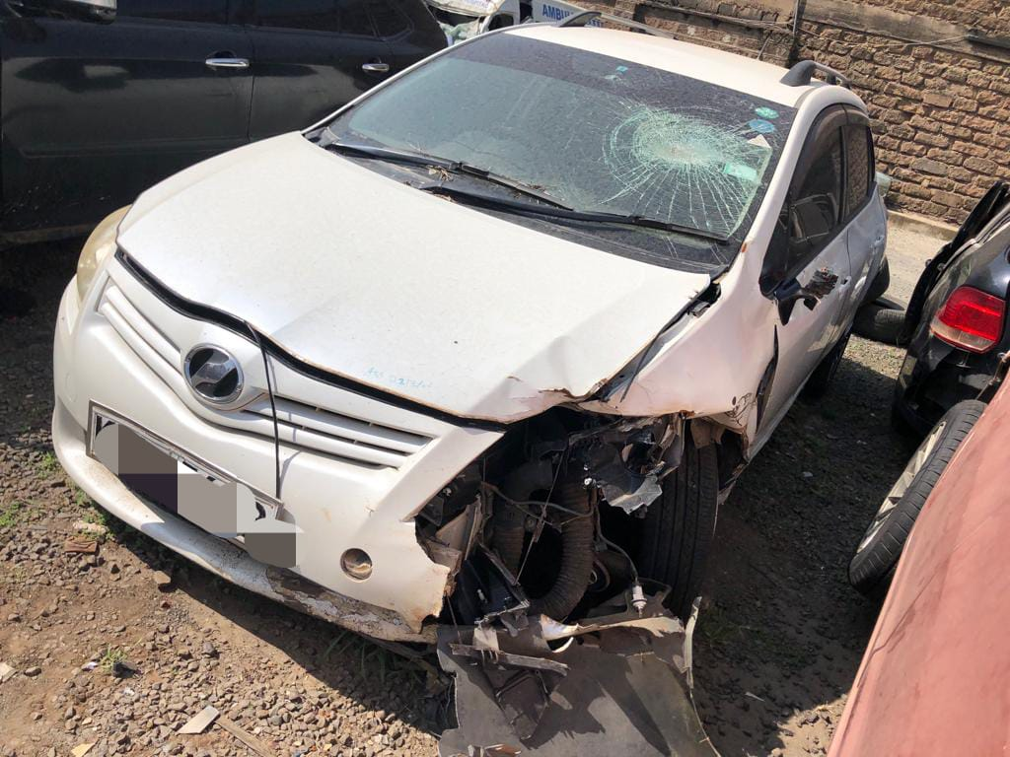
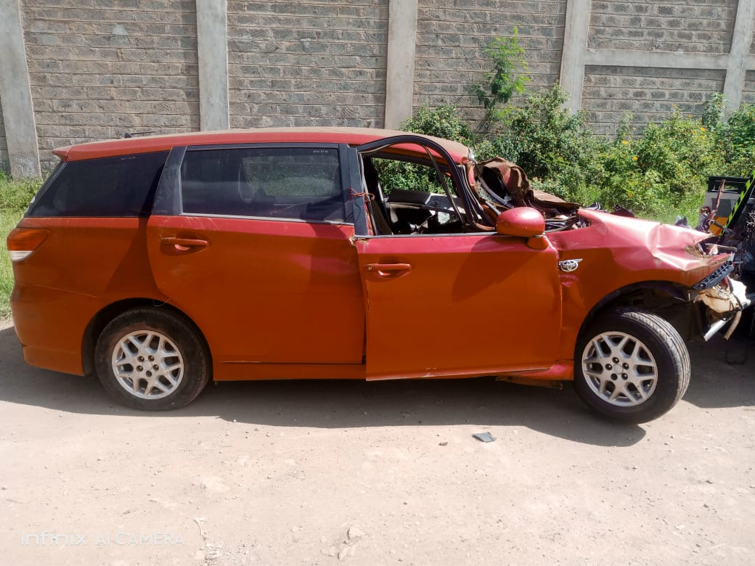



Salvage
CARS
KENYA
Contact Us
Salvage CARS KENYA
Buying and selling of salvage cars/ salvage spares within Kenya
Derichie7@gmail.com
+254 706175258

